Slide 1


Crop production and management
1
Introduction
Introduction
In previous class we learnt that plants can make their own food using the process photosynthesis but animals including human beings can’t make their food. All animals get their food from plant and animals source. In this chapter we will learn about how these plant source food is cultivated.
Crops
Introduction
When plants of the same kind are cultivated at one place on a large scale is called a crop. Agriculture is the cultivation of land for effective crop growth and raising of livestock. The crop can be classified on two types based on the suitable seasons the crop require –
Kharif – The crops which are sown in the rainy season are called Kharif crops e.g. Rice can be grown in the rainy season (kharif crop) they required more water. If wheat is sown in the kharif season ,it will not grow well. This is because wheat plants cannot tolerate too much water of the rainy season.
Rabi - The crops that is sown in the winter season is called Rabi crops e.g. Wheat and mustard can be grown in winters as they require short cool seasons.
Cultivation of crops
Introduction
Preparation of Soil
1
Aayush - CBSE Class 7 Science
1
Crop production and management

Slide 2
Crops
Kharif
Rabi
Classification of Crops
Before cultivating any crop the soil is loosen and turned. The process of loosening and turning of the soil is called tilling or ploughing.
Ploughing the field before cultivating is beneficially because:
The loose soil allows the plant roots to penetrate freely and deeply into the soil so that plants are held more firmly to the ground.
The loose soil allows the roots of plants to breathe easily.
The loose soil help in the growth of worms and microbes present in the soil who are friends of the farmer.
It also uproots and buries weeds standing in the field.
Turning the soil is for uprooting weeds and aerating the soil
Method of ploughing
Ploughing can be done with the help of plough or hoe or with cultivator:
Plough : This is made of wood or iron and is drawn by a pair of bulls or other animals (horses and camels). It contains a strong triangular iron strip called ploughshare. The main part of the plough is a long log of wood which is called a plough shaft. There is a handle at one end of the shaft. The other end is attached to a beam which is placed on the bulls’ necks. One pair of bulls and a man can easily operate the plough.
Hoe : It is a simple tool which is used for removing weeds and for loosening the soil. It has a long rod of wood or iron. A strong, broad and bent plate of iron is fixed to one of its ends and works like a blade.
Aayush - CBSE Class 7 Science
2
Crop production and management

Slide 3
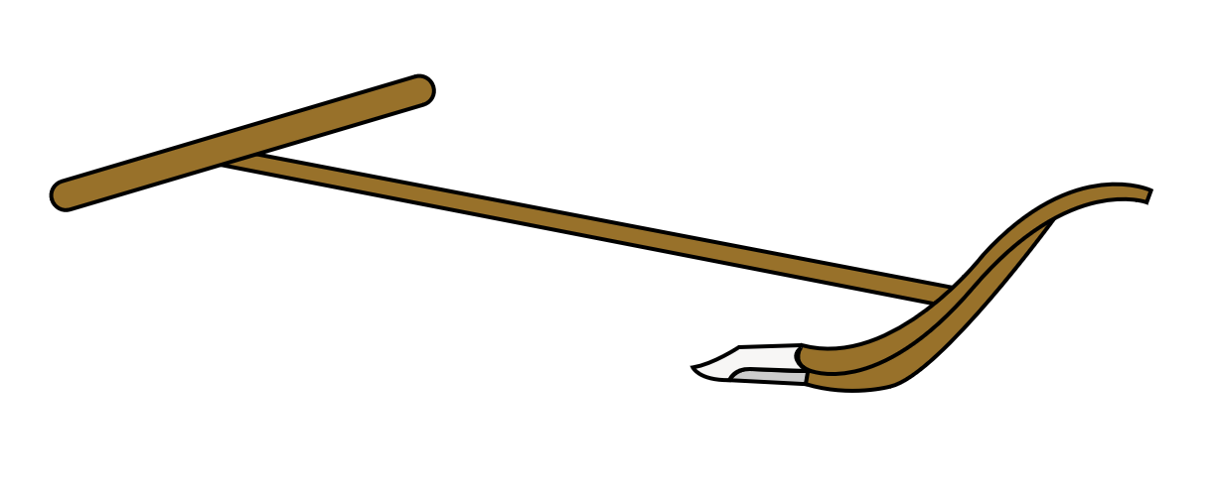
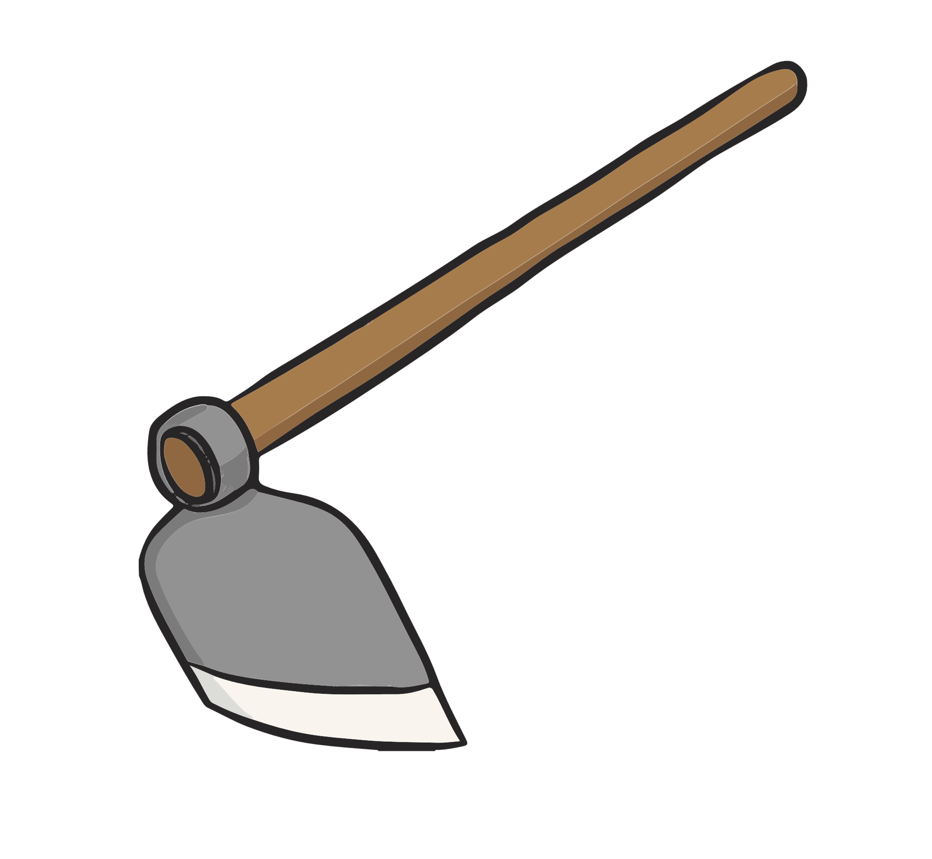
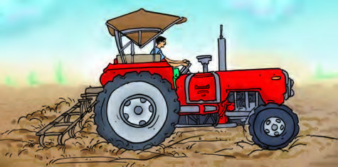
Shaft
Beam
Share
A Plough
Bent Plate
Rod
A Hoe
Cultivator : Cultivator is a tractor-driven machine and is commonly used nowadays. it reduces time and saves labour.
After Ploughing the soil is now ready for levelling. For levelling farmers use leveller.
A Cultivator
Aayush - CBSE Class 7 Science
3
Crop production and management

Slide 4
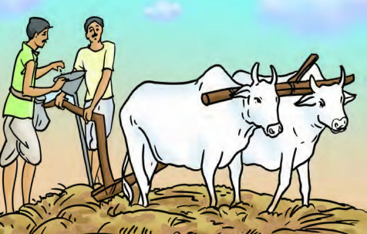
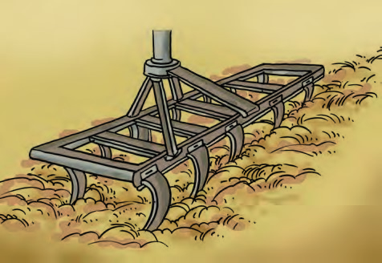
Sowing
2
Sowing seeds is an essential part of crop production. After the preparation of soil, the seeds are scattered in the field. This process is called sowing. Farmers prefer to use seeds which give high yield. To do so the seeds are soaked in water since the damaged seeds is hollow and thus lighter will float in water and the good seeds will sink. Seeds are sown in appropriate distance to avoid overcrowding of plants and allow plants to get sufficient sunlight, nutrients and water from the soil.
Traditional tool
The tool used traditionally for sowing seeds is shaped like a funnel. The seeds are filled into the funnel, passed down through two or three pipes having sharp ends. These ends pierce into the soil and place seeds there.
Modern tool
The seed drill is used for sowing with the help of tractors. It sows the seeds uniformly at equal distance and depth. It ensures that seeds get covered by the soil after sowing. This protects seeds from being eaten by birds. Sowing by using a seed drill saves time and labour
Traditional tool for sowing
Seed Drill
Aayush - CBSE Class 7 Science
4
Crop production and management

Slide 5
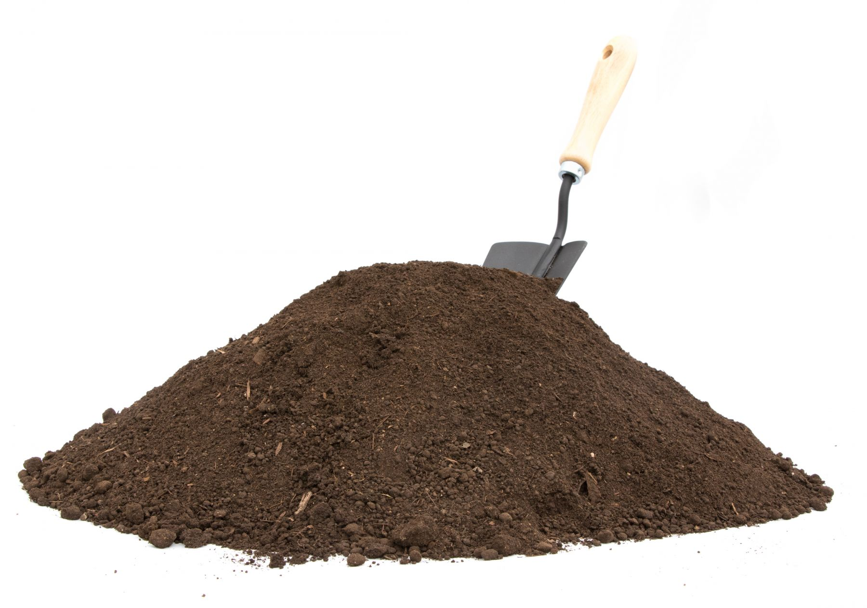
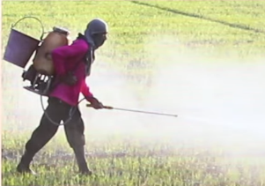
Adding Manure and Fertilisers
3
Repeated growing of crops in the same field removes a lot of precious minerals, elements, organic matter and other material from the soil. Due to this soil become infertile after some time, and the crop yield decreases. The deficiency of plant nutrients and organic matter in the soil is made by adding manures and fertilisers to the soil.
Manures
Manure is an organic substance obtained from the decomposition of plant or animal wastes. Farmers dump plant and animal waste in pits at open places and allow it to decompose. The decomposition is caused by some microorganisms (vermicomposting). The decomposed matter is used as organic manure.
Fertilisers
Fertilisers are chemicals which are rich in a particular nutrient. Some examples of fertilisers are— urea, ammonium sulphate, super phosphate, potash, NPK (Nitrogen, Phosphorus, Potassium).
Fertilisers help farmers to grow better yield but excessive use of fertilisers can cause soil unfertile and has become a source of soil pollution.
Manures
Fertilisers
Aayush - CBSE Class 7 Science
5
Crop production and management

Slide 6
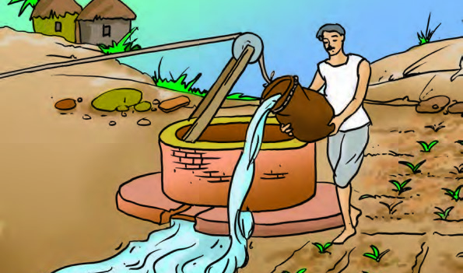
Advantages of manures over fertilisers:
It enhances the water holding capacity of the soil.
It makes the soil porous due to which exchange of gases becomes easy.
it increases the number of friendly microbes.
it improves the texture of the soil.
Crop Rotation
Rhizobium bacteria are present in the nodules of roots of leguminous plants. Which helps plants to fulfil the nitrogen requirements by converting atmospheric gas to usable nitrogen by the plants which go into the soil and improves the fertility.
In crop rotation cereal crops like wheat, maize, paddy, millet are grown alternately with leguminous crops like pulses, peas, beans, groundnut, clover in the same field.
Irrigation
4
Water is important for proper growth and development for both animals and plants. Water is essential because the plants are 90% made of water and germination of seeds does not take place under dry conditions. Nutrients dissolved in water are transported to each part of the plant. Water also protects the crop from both frost and hot air currents.
The supply of water to crops at regular intervals is called irrigation. Kharif crops require more water that Rabi crops. In summer, the frequency of watering is higher because of high rate of evaporation.
Wells, tube wells, ponds, lakes, rivers, dams and canals are the sources water for irrigation of plants.
Traditional Methods
The various traditional ways for irrigation are:
Moat (Pully system)
Chain Pump
Dhekli
Rahat (Lever system)
Moat
Aayush - CBSE Class 7 Science
6
Crop production and management

Slide 7
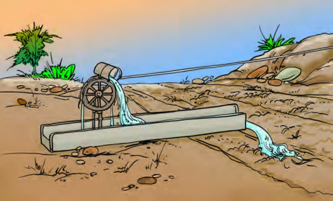
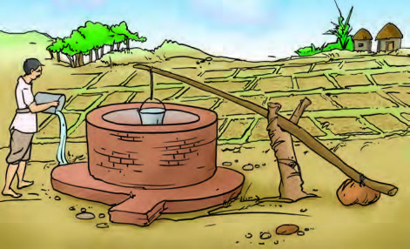
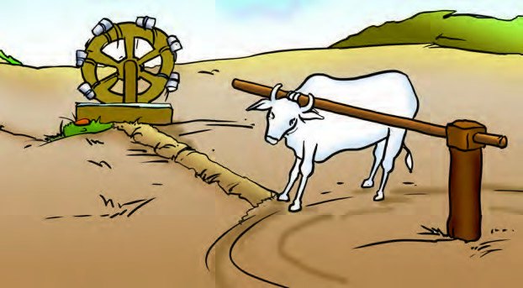
Chain Pump
Dhekli
Rahat
Modern Methods
Modern methods of irrigation help us to use water economically. The main methods used are as follows:
Sprinkler System: This system is more useful on the uneven land where sufficient water is not available. The perpendicular pipes, having rotating nozzles on top, are joined to the main pipeline at regular intervals. When water is allowed to flow through the main pipe under pressure with the help of a pump, it escapes from the rotating nozzles. It gets sprinkled on the crop as if it is raining. Sprinkler is very useful for lawns, coffee plantation and several other crops
Aayush - CBSE Class 7 Science
7
Crop production and management

Slide 8
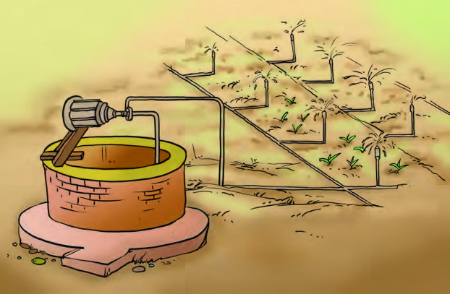
Sprinkling System
Drip system : In this system, the water falls drop by drop directly near the roots. So it is called drip system. It is the best technique for watering fruit plants, gardens and trees [Fig. 1.5(b)]. Water is not wasted at all. It is a boon in regions where availability of water is poor.
Protection for crops
5
In a field many other undesirable plants may grow naturally along with the crop. These undesirable plants are called weeds.
The removal of weeds is called weeding. Weeding is necessary since weeds compete with the crop plants for water, nutrients, space and light. Thus, they affect the growth of the crop. Some weeds interfere even in harvesting and may be poisonous for animals and human beings.
Tilling before sowing of crops helps in uprooting and killing of weeds, which may then dry up and get mixed with the soil. The best time for the removal of weeds is before they produce flowers and seeds. The manual removal includes physical removal of weeds by uprooting or cutting them close to the ground, from time to time. This is done with the help of a khurpi.
Aayush - CBSE Class 7 Science
8
Crop production and management

Slide 9
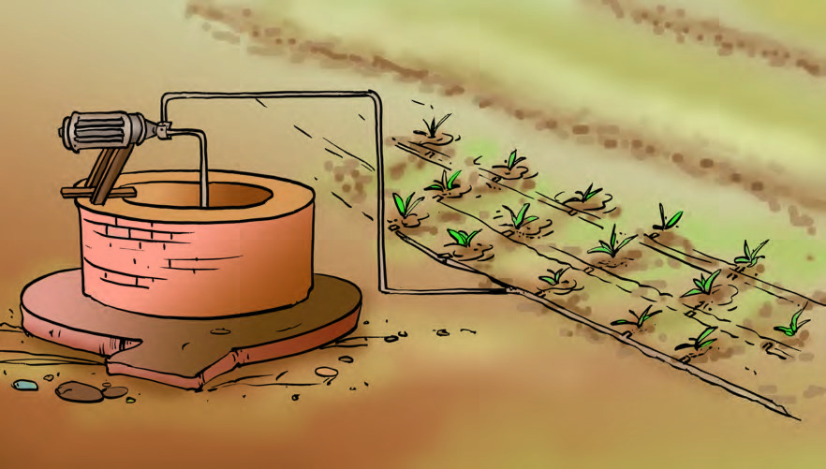
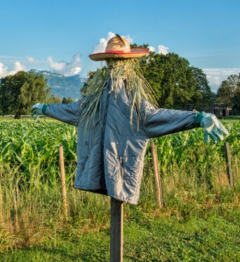
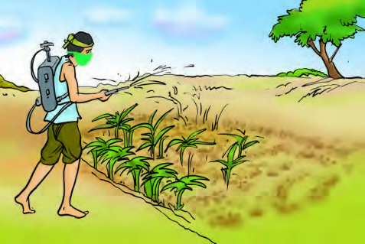
Drip System
Weeds are also controlled by using certain chemicals, called weedicides, like 2,4-D. These are sprayed in the fields to kill the weeds. The weedicides are diluted with water to the extent required and sprayed in the fields with a sprayer.
Besides this many insects harm crops. Farmers spread insecticides to kill insects in the crop. Farmers also put scarecrows to scare the birds.
Scarecrow
Farmer spreading weedicides
Aayush - CBSE Class 7 Science
9
Crop production and management

Slide 10
Harvesting
6
The cutting of crop after it is mature is called harvesting.
It usually takes 3 to 4 months for a cereal crop to mature. Harvesting in our country is either done manually by sickle (Fig. 1.7) or by a machine called harvester.
In the harvested crop, the grain seeds need to be separated from the chaff. This process is called threshing. This is carried out with the help of a machine called ‘combine’ which is in fact a harvester as well as a thresher
Farmers with small holdings of land do the separation of grain and chaff by winnowing.
Winnowing is the method in which heavier components of the mixture are separated from the lighter substances with the help of wind.
Storage
7
Storage of produce is an important task. If the harvested grains are to be kept for longer time, they should be safe from moisture, insects, rats and microorganisms. Harvested grains have more moisture. If freshly harvested grains (seeds) are stored without drying, they may get spoilt or attacked by organisms, making them unfit for use or for germination. Hence, before storing them, the grains are properly dried in the sun to reduce the moisture in them. This prevents the attack by insect pests, bacteria and fungi.
Farmers store grains in jute bags or metallic bins. However, large scale storage of grains is done in silos and granaries to protect them from pests like rats and insects
Aayush - CBSE Class 7 Science
10
Crop production and management

